Slide 1

Protein Classification from Single Amino-Acid Sequence
Team1 : JinSu Kim, JaeWon Lee, Bohyun Ryou, Hyunjung Kim, WooJong Kim
KIAS CAC Summer School 2022 Project

Slide 2
Introduction

Slide 3
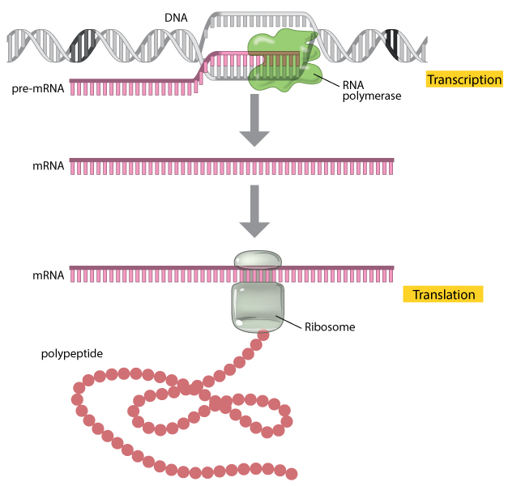
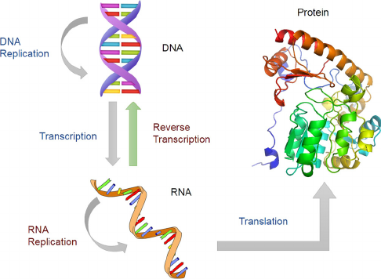
Background
Anfinsen’s thermodynamic hypothesis (Nobel prize 1973):
The native 3D structure of protein is determined solely by the amino acid sequence.

Slide 4
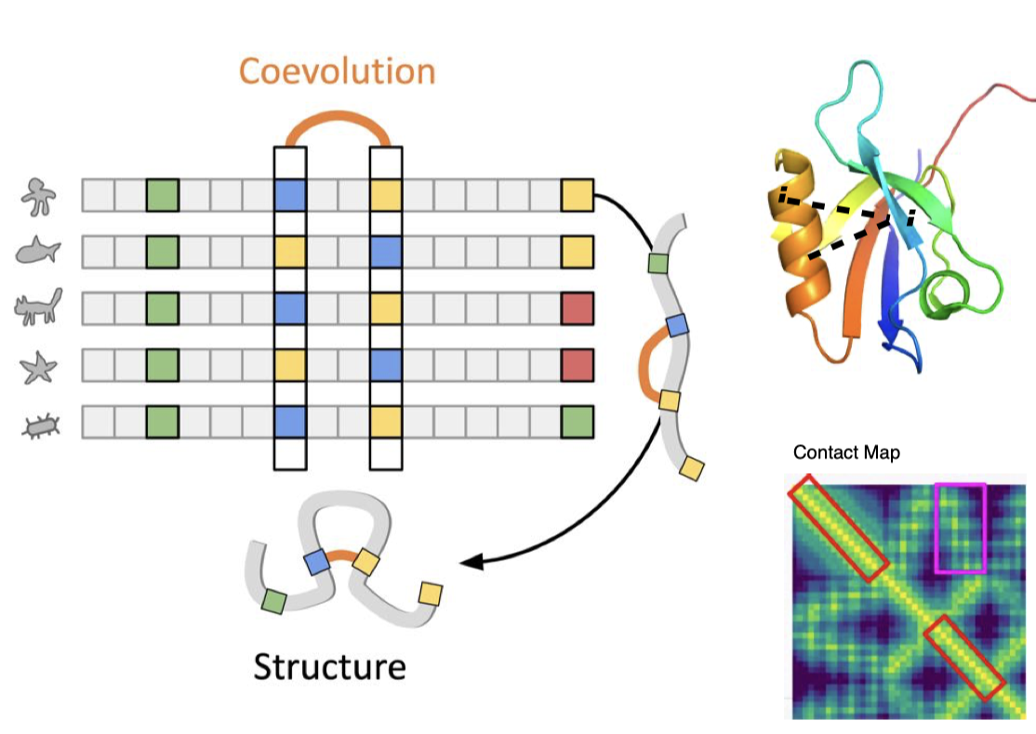
Multiple Sequence Alignment
Notes:
msa 를 주로 하는 예측
msa 오래 걸림.
정확하지도 않음.
없는것들도 있음
msa 없이도 정보를 얻을 수 는 없을까?

Slide 5
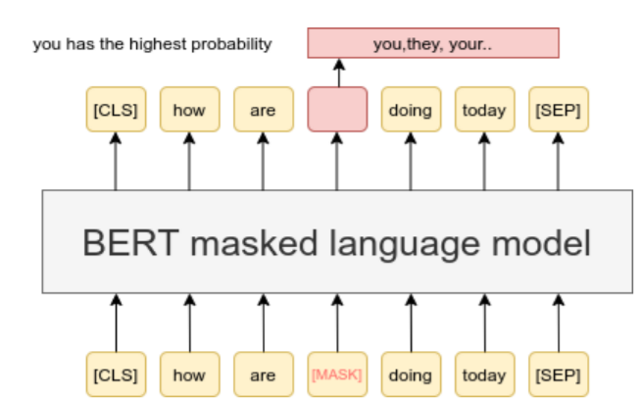
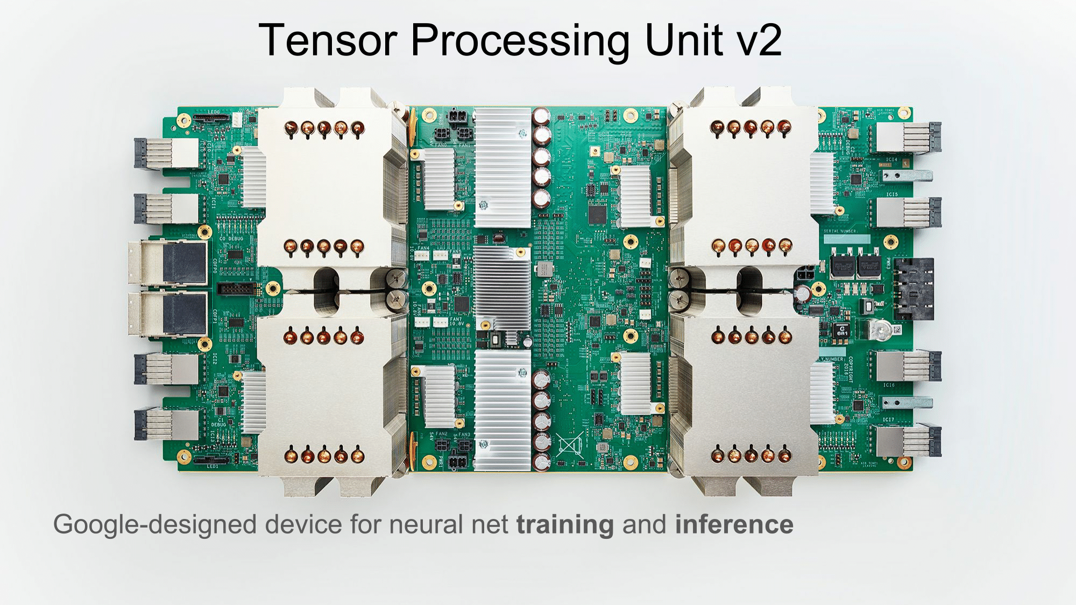

Modeling protein using language model
ProtBert[1]
512 TPU
150GB dataset
420M parameters
1024 embedding dim
30 layer
Masked-LM task
[1] ProtTrans: Towards Cracking the Language of Life’s Code Through Self-Supervised Learning
Notes:
단백질을 langurage modle로 모델링
이미 엄청 큰 데이터로 학습된 모델이 있음

Slide 6
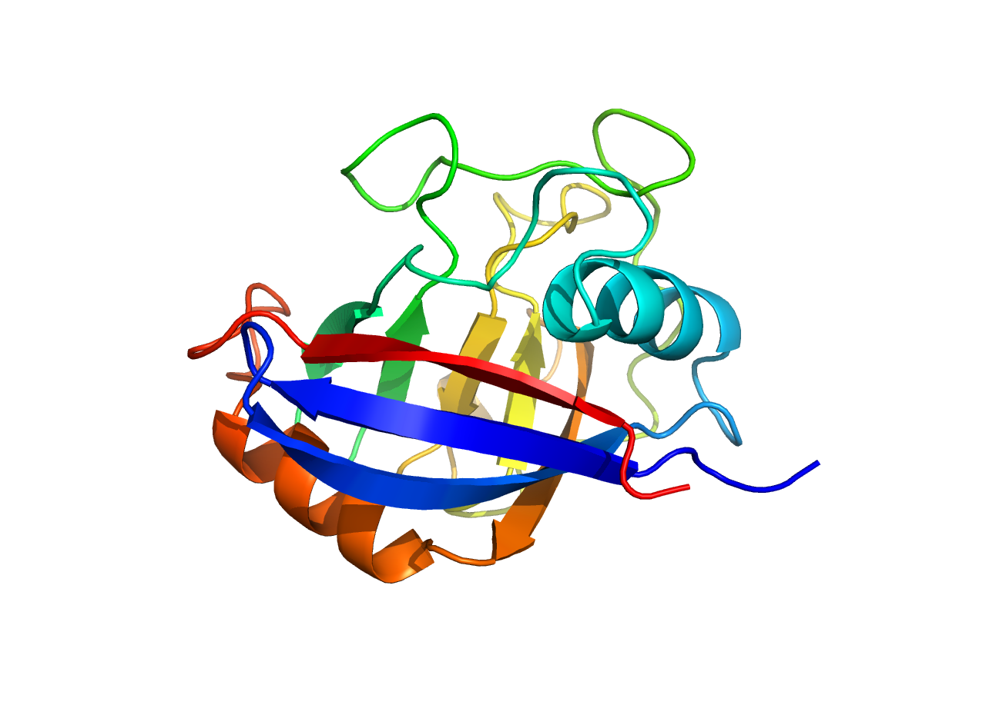
Project Topic
Downstream task
Protein function classification : PDB dataset
Protein structure classification : CATH dataset
Motivation & Significance
Obtaining information without MSA
Assistant to find expert model
Scalability to complex task (ex: protein binding)
Notes:
하는 이유
1 msa 없이도 seq만으로 좋은 정보를 알고싶다
msa 정보 없이도 protein bert가 일종의 단백질 언어를 학습했다고 하면 구조도 잘 예측할 것이다 (가장 큰 이유)-pseudo msa
2 모델 선택에 도움을 줄 수 있다 (=Provide intuition for model selection)
여러 모델이 있을 때 각 모델이 잘하는 protein을 class로 놓고 학습해서 어떤 class 속할지 예측해 선택에 도움을 줄 수 있다
3 모델의 확장가능성
더 복잡한 task 나 네트워크 예를 들어 binding같은게 있다.
구조도 물론 중요하지만 다른 변수도 많기 때문에 예측하기 전에
좀더 쉬운태스크로 downstream task 학습이 가능성이 있는지 확인해본다.
이것도 못하면 더 어려운건 어짜피 못할 거라고 생각하기 때문.
Learning speed
Multi-class classification
Small, Imbalanced dataset
Model Implementatio

Slide 7
Data

Slide 8
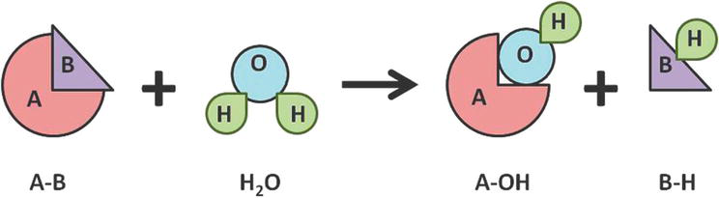
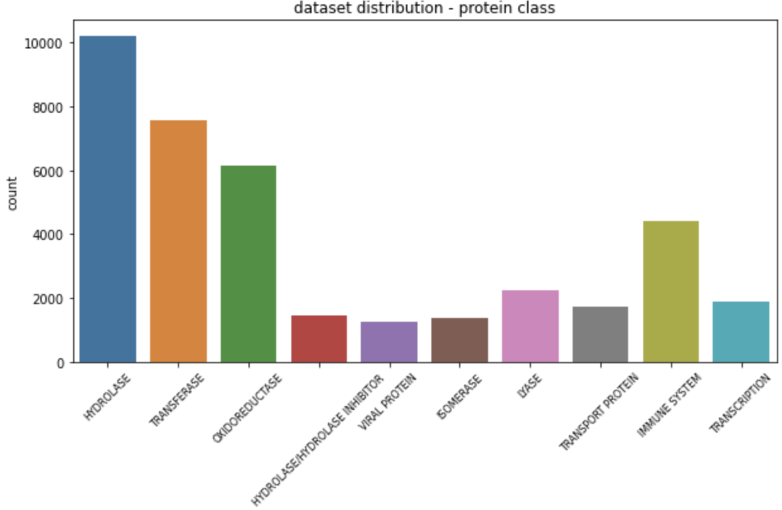
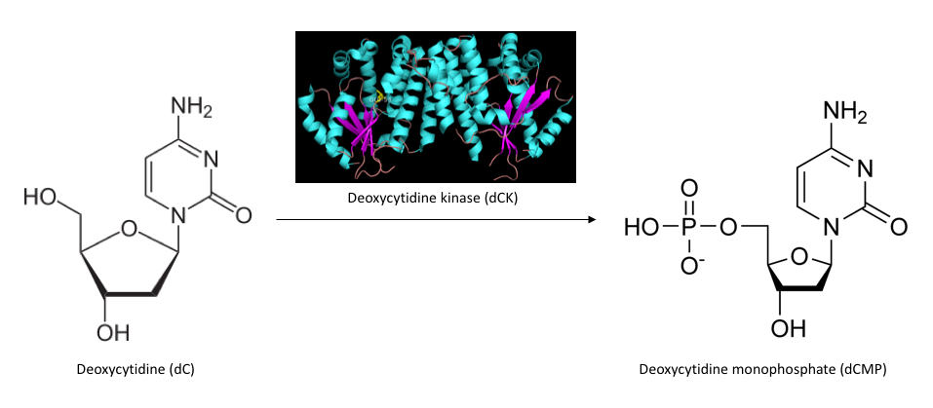
Data
Dataset 1
Protein function classification: from PDB dataset
data len = 37503

Slide 9
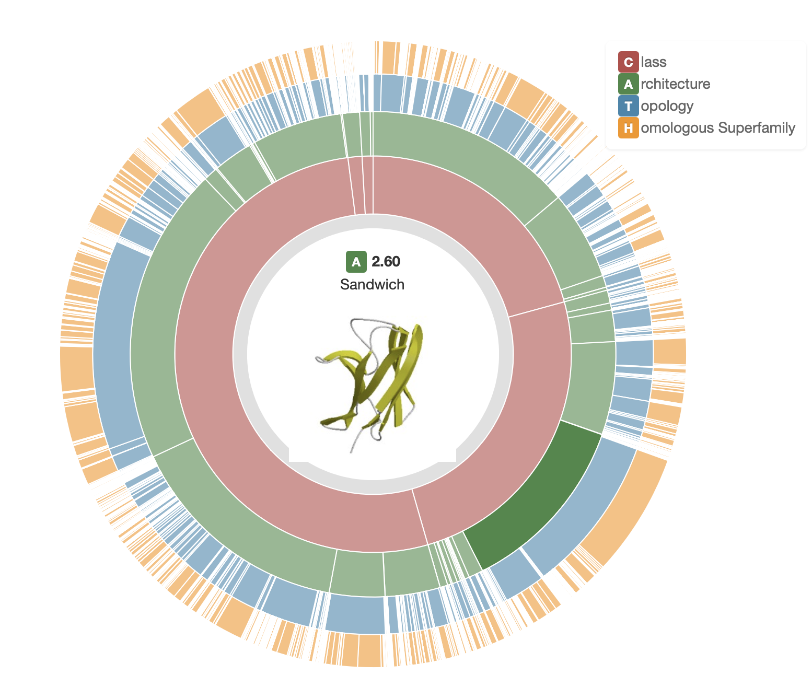
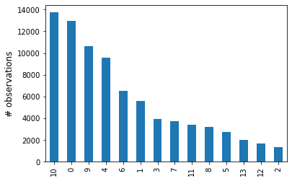
Data
Dataset 2
Protein structure classification : from CATH dataset
data len = 80969

Slide 10
Methodology
& Algorithm

Slide 11
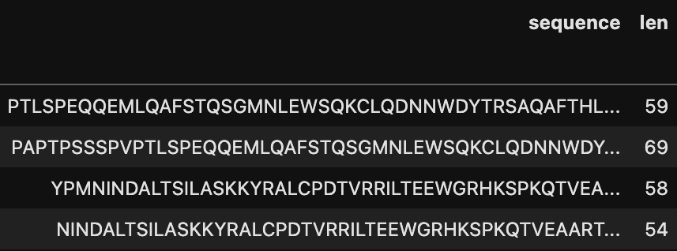
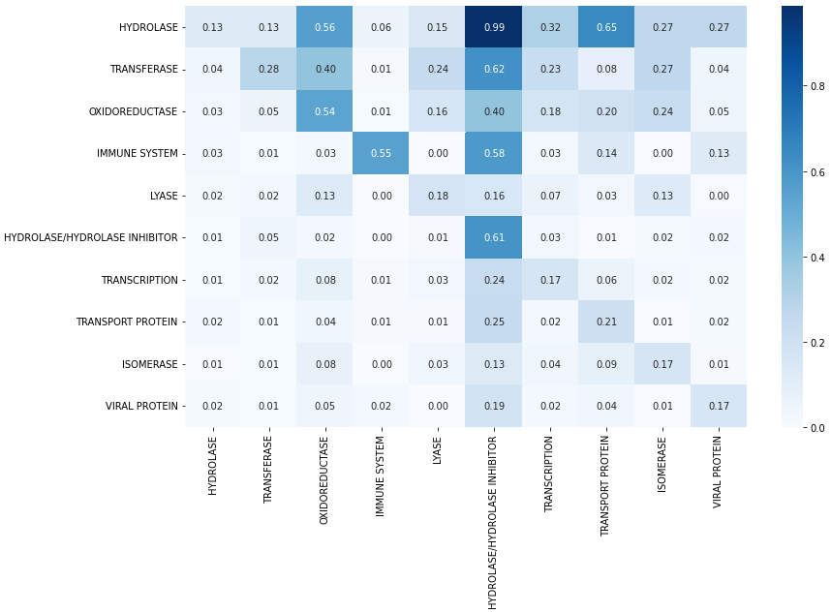
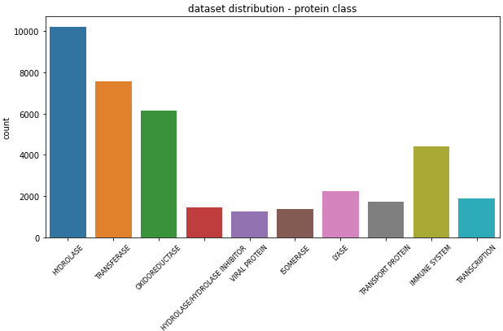
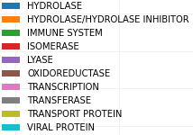
Methodology and Algorithm
Model

Slide 12
Methodology and Algorithm
Classification with vector embedded by n-gram tokenizer
Naive Bayesian, Adaboost, Nearest Centroid
SGDClassifier, Decision-Tree, RandomForest
Deep Learning Model
pre-trained BERT model
CNN model
linear model
Notes:
ngram 설명, 그림

Slide 13
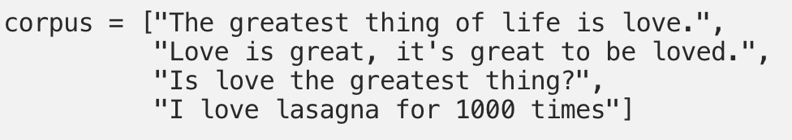
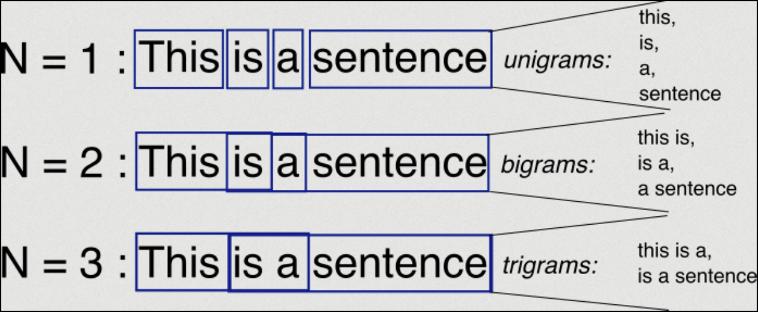
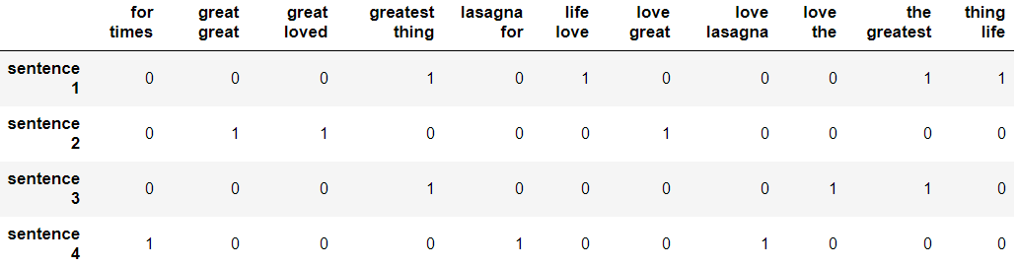
Methodology and Algorithm
N-gram
N-gram model is a type of probabilistic language model for predicting the next item in such a sequence in the form of a (n − 1)–order Markov model.
N-gram models(and algorithms that use them) benefits are relative simplicity and scalability, with larger n, a model can store more context, enabling smaller experiments to scale up from larger
Notes:
ngram 설명, 그림

Slide 14
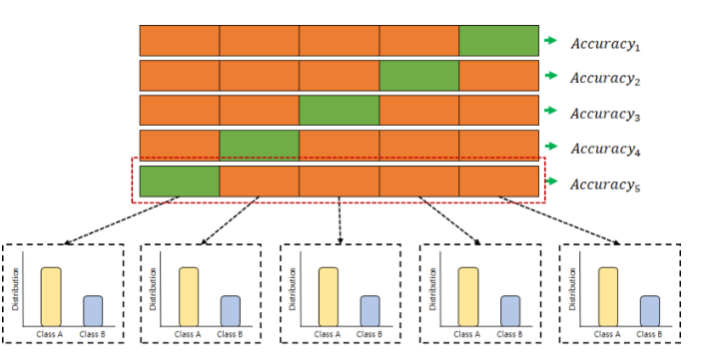
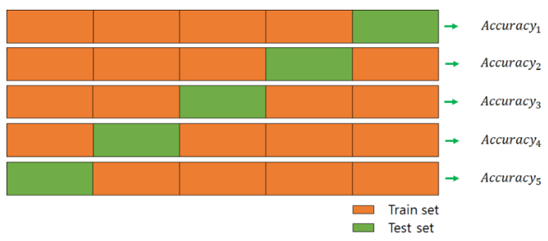
Methodology and Algorithm
Training : Cross Validation(n=8)
K-Fold Cross validation
Stratified K-Fold Cross Validation : Imbalanced dataset

Slide 15


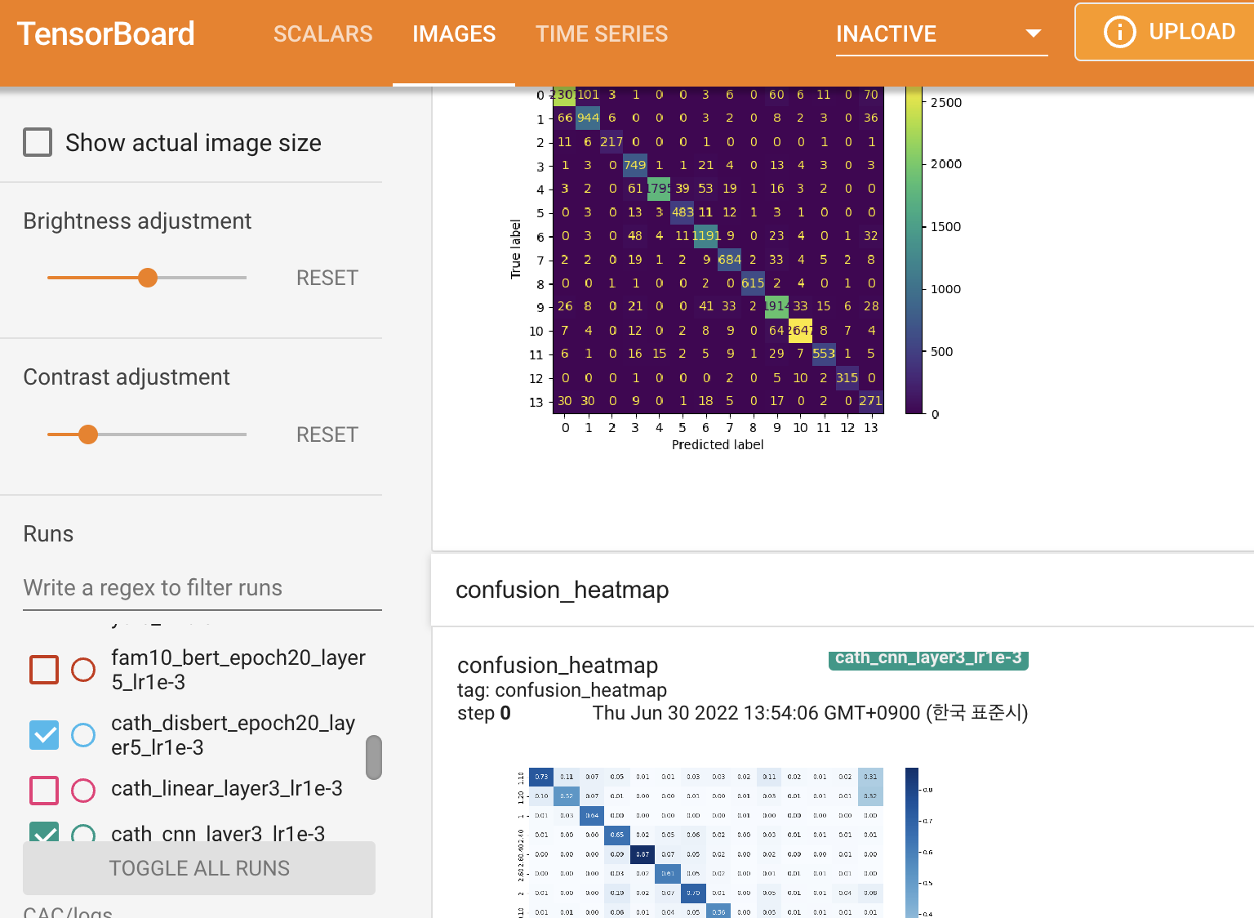


Methodology and Algorithm
BERT Training :Torch, Huggingface, Horovod, MPI, tensorboard
20 epoch : 6 hour -> 40 min (8 gpu)

Slide 16
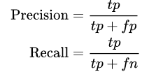
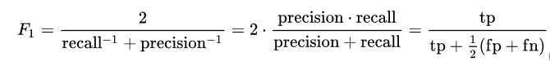
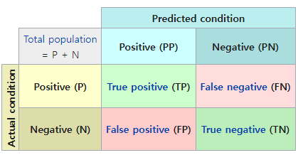
Methodology and Algorithm
Evaluation
Macro F1 Score = Calculate F1 scores per each class and get their unweighted mean
Confusion Matrix : Error matrix which reports the number of TP / FP/ TN/ FN

Slide 17
Result

Slide 18
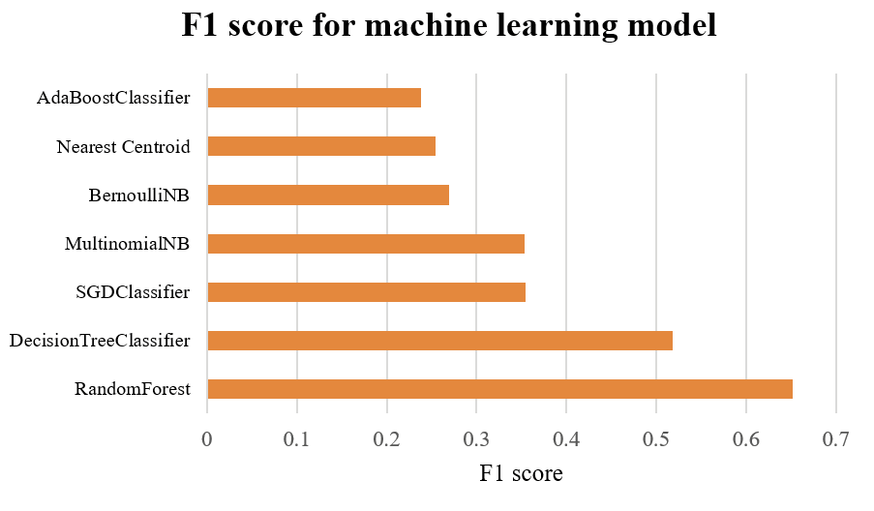
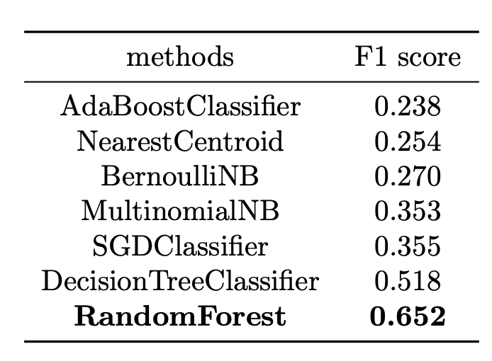
Task 1 : Protein classification (PDB class)
Classification with vector embedded by n-gram tokenizer
Notes:
※ These algorithm can use sparse matrix as input variables

Slide 19
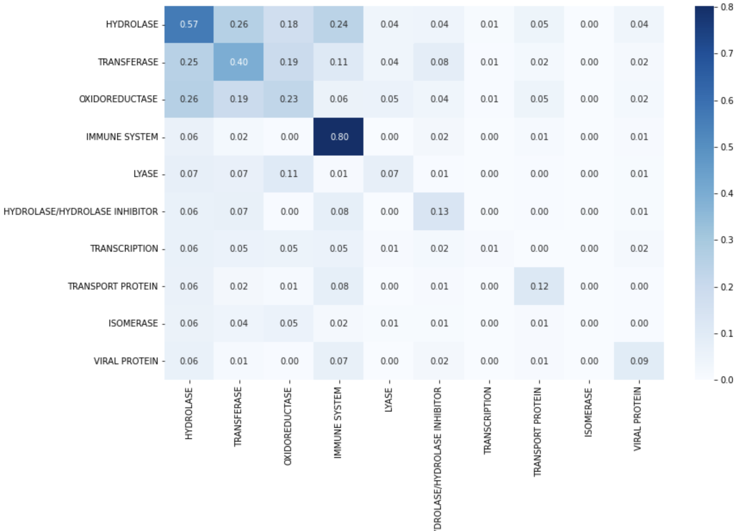
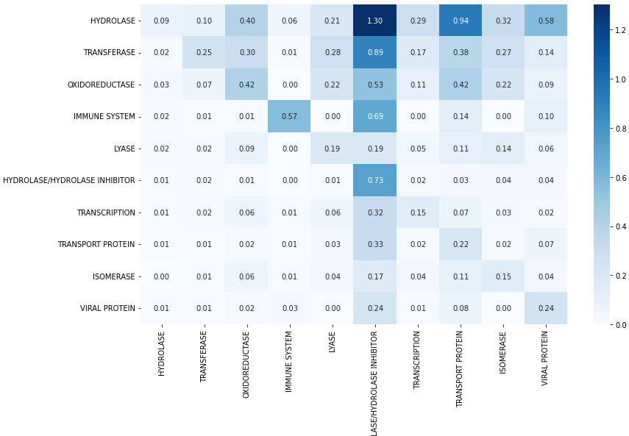
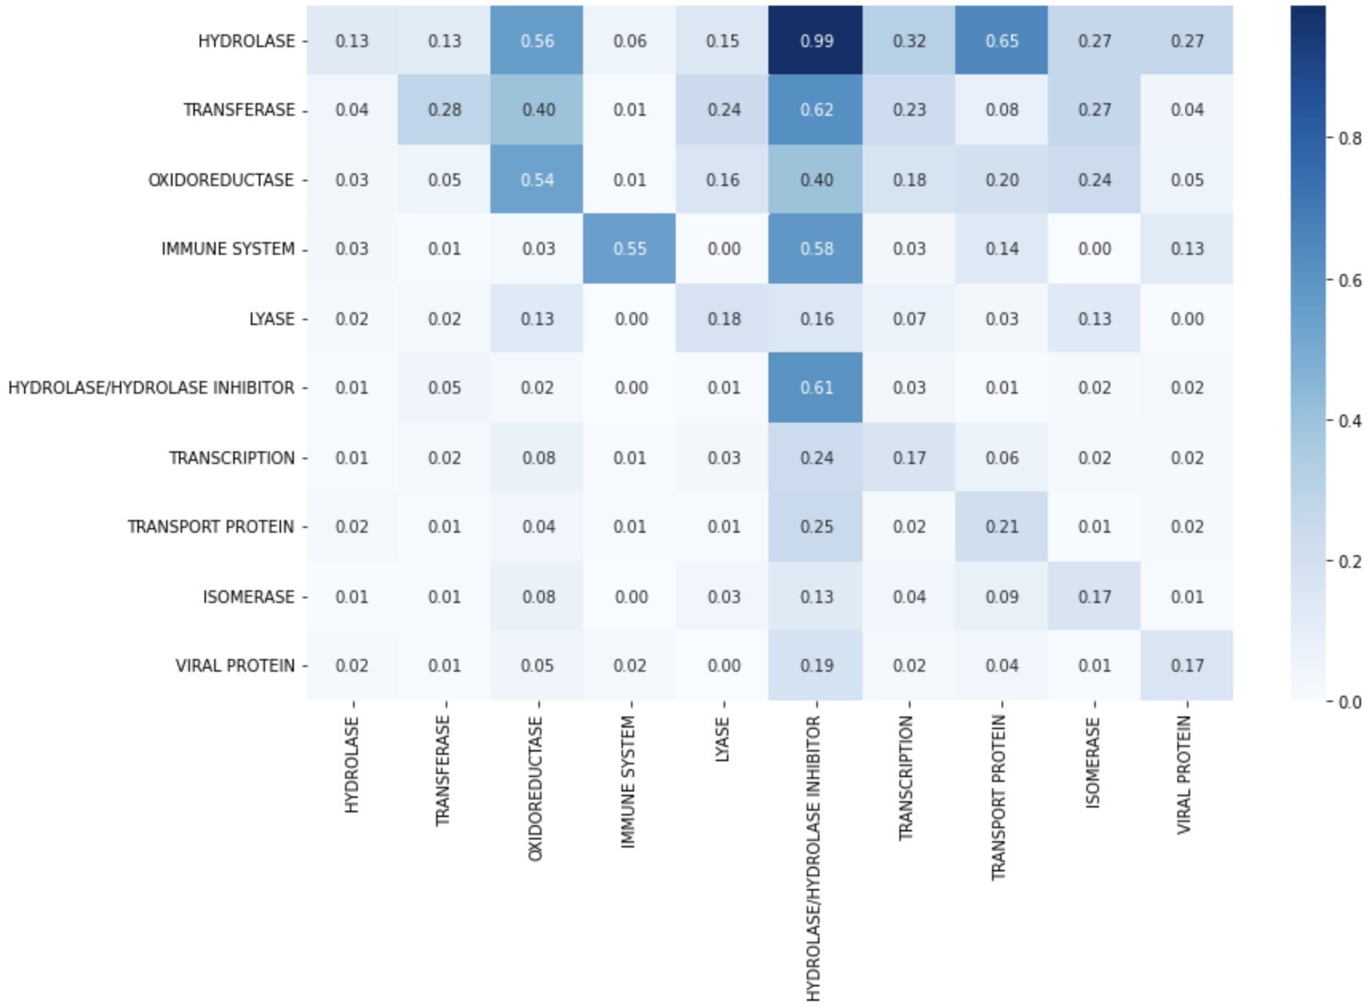
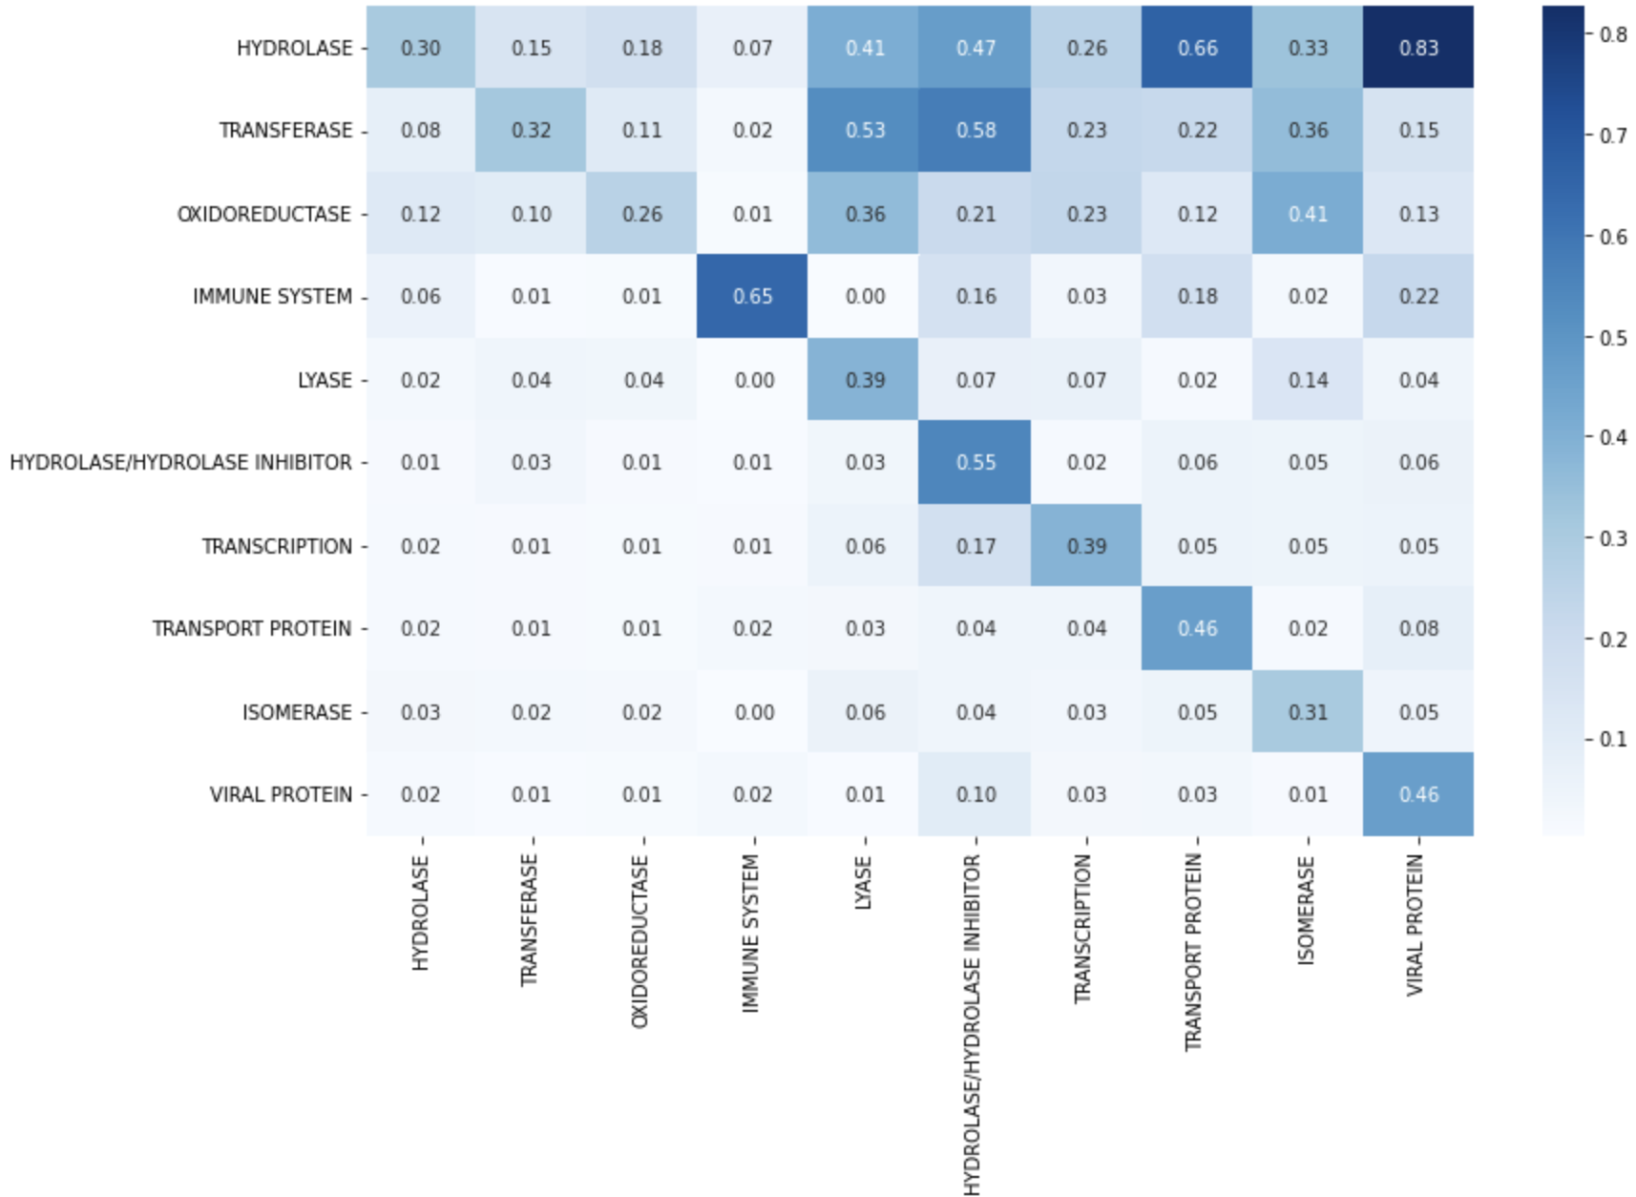
Task 1 : Protein classification (PDB class)
Adaboost 2-gram token
F1 score: 0.238
NearestCentroid 2-gram token
F1 score: 0.254
MultinomialNB 2-gram token gini impurity max leaf : None
F1 score: 0.353
BernoulliNB 2-gram token
F1 score: 0.270

Slide 20
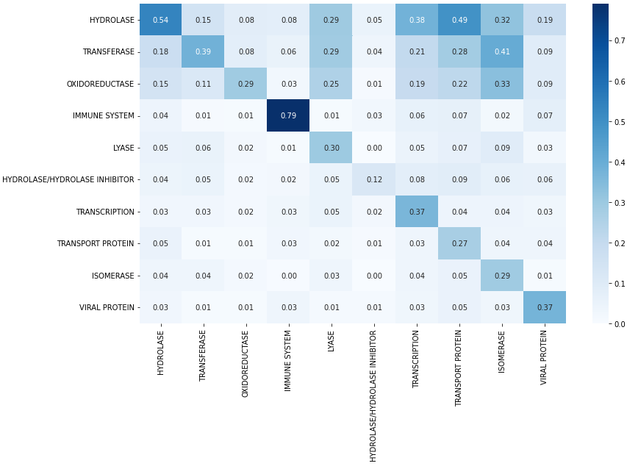
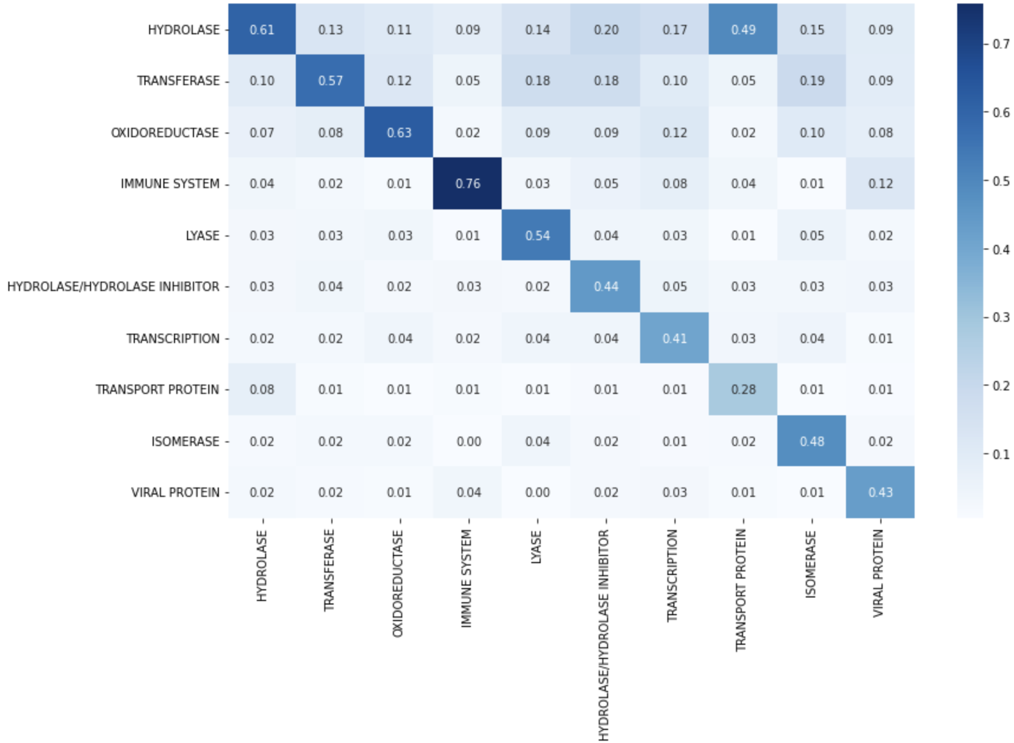
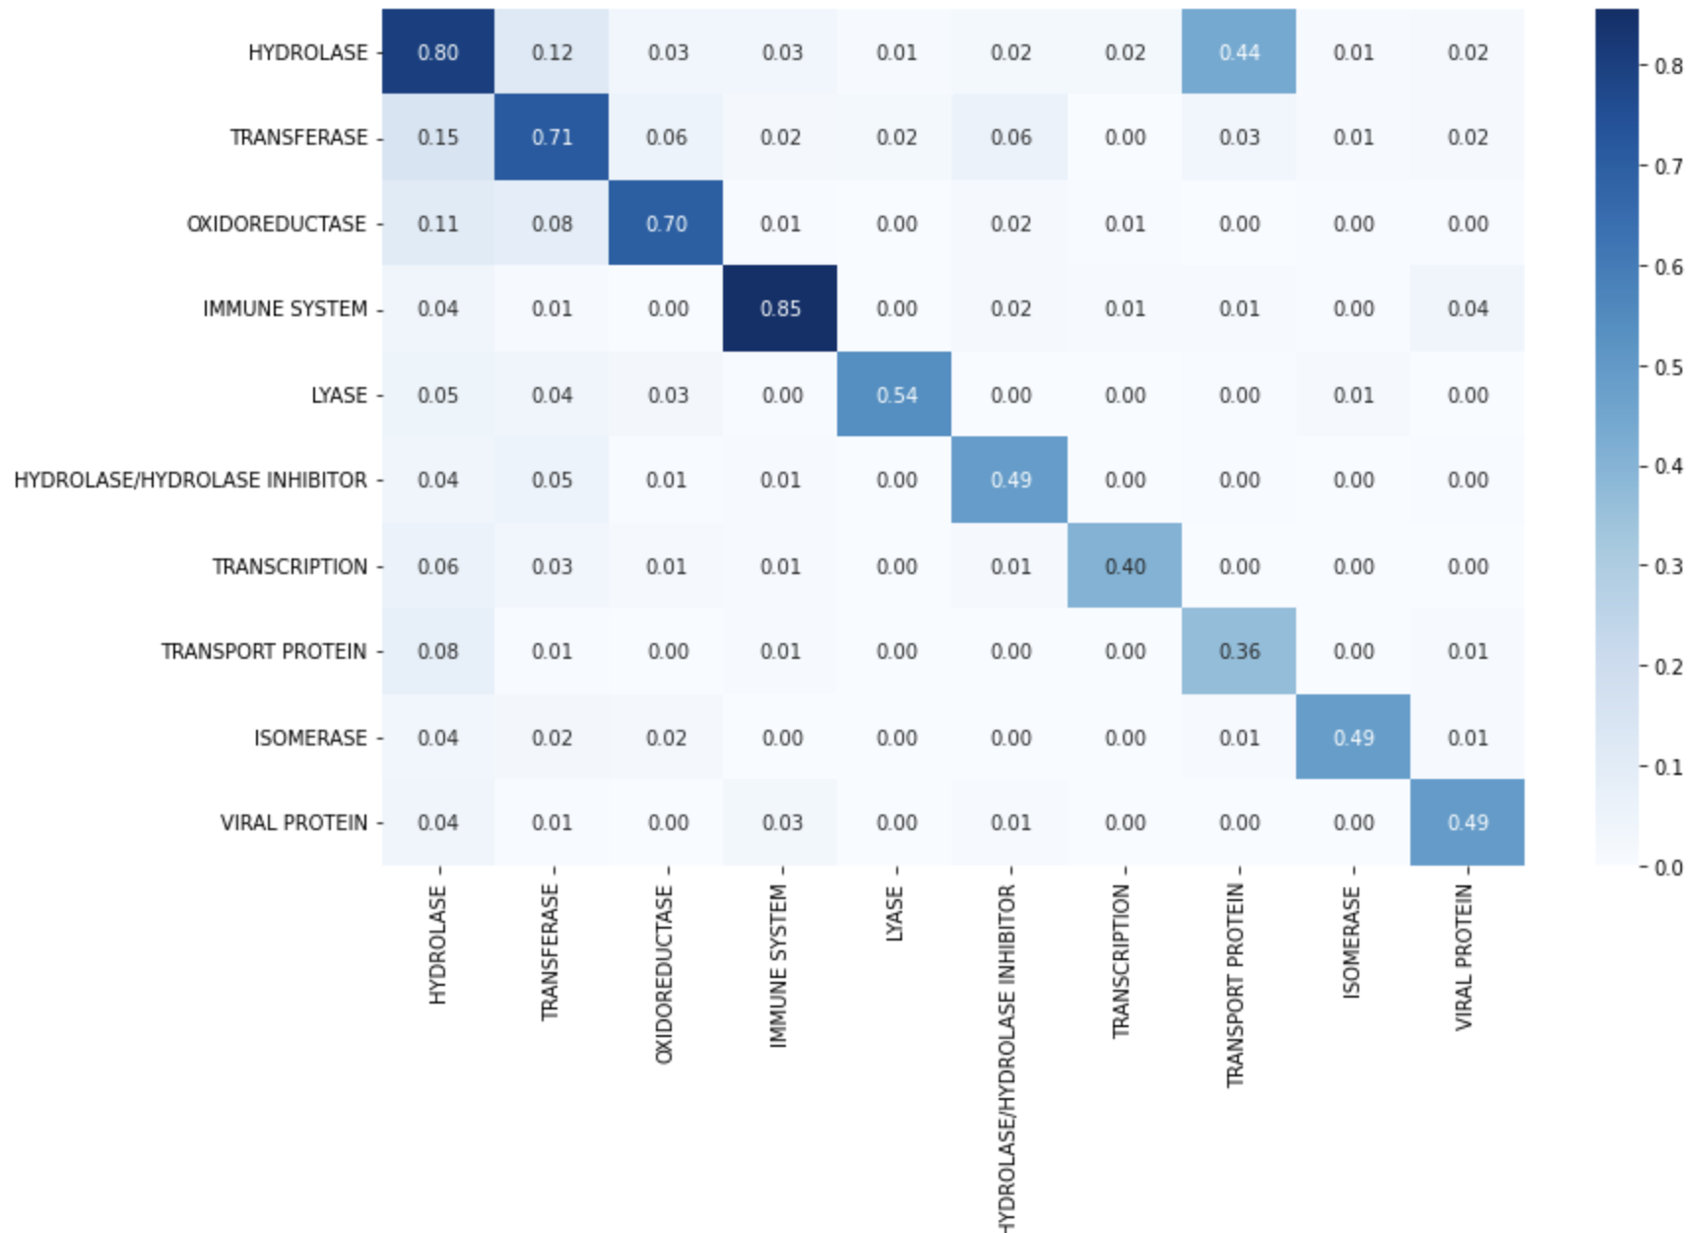
Task 1 : Protein classification (PDB class)
SGDClassifier 2-gram token gini impurity max leaf : None
F1 score: 0.36
Decision Tree Classifier 2-gram token gini impurity max leaf : None
F1 score : 0.518
RandomForest 2-gram token 128 estimators
F1 score: 0.652

Slide 21
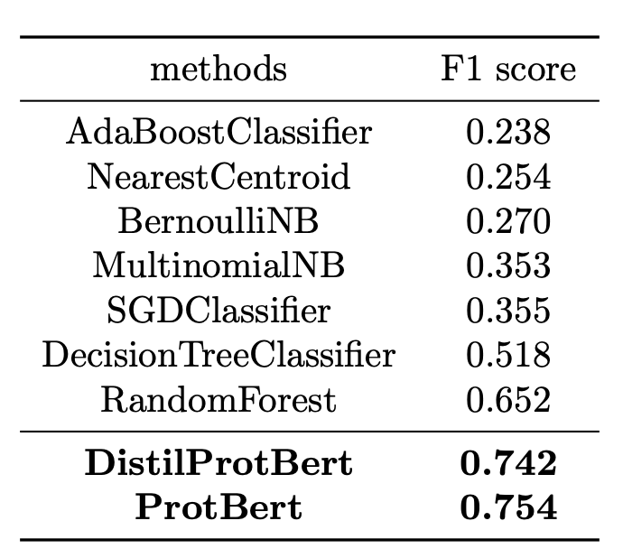
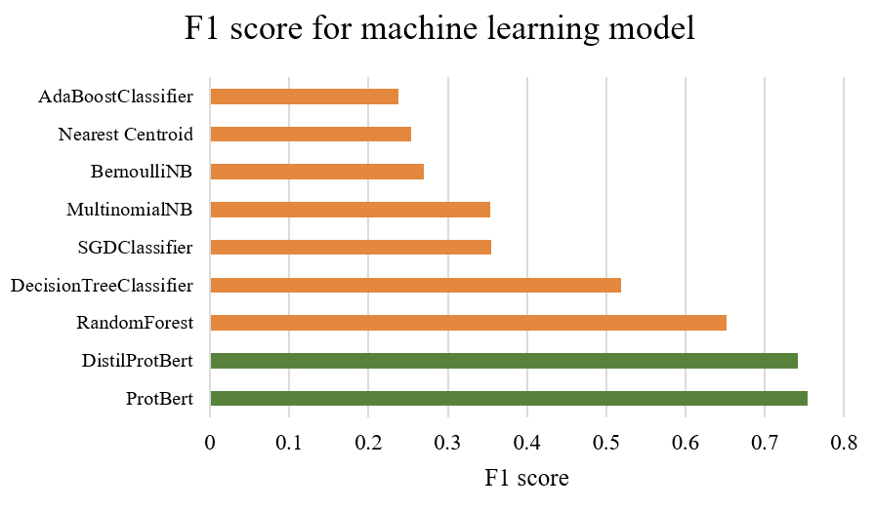
Task 1 : protein classification (PDB class)
BERT based model : pre-trained BERT
transfer learning except last 5 layer
Notes:
버트가 좋은 정보를 가지고 있다

Slide 22
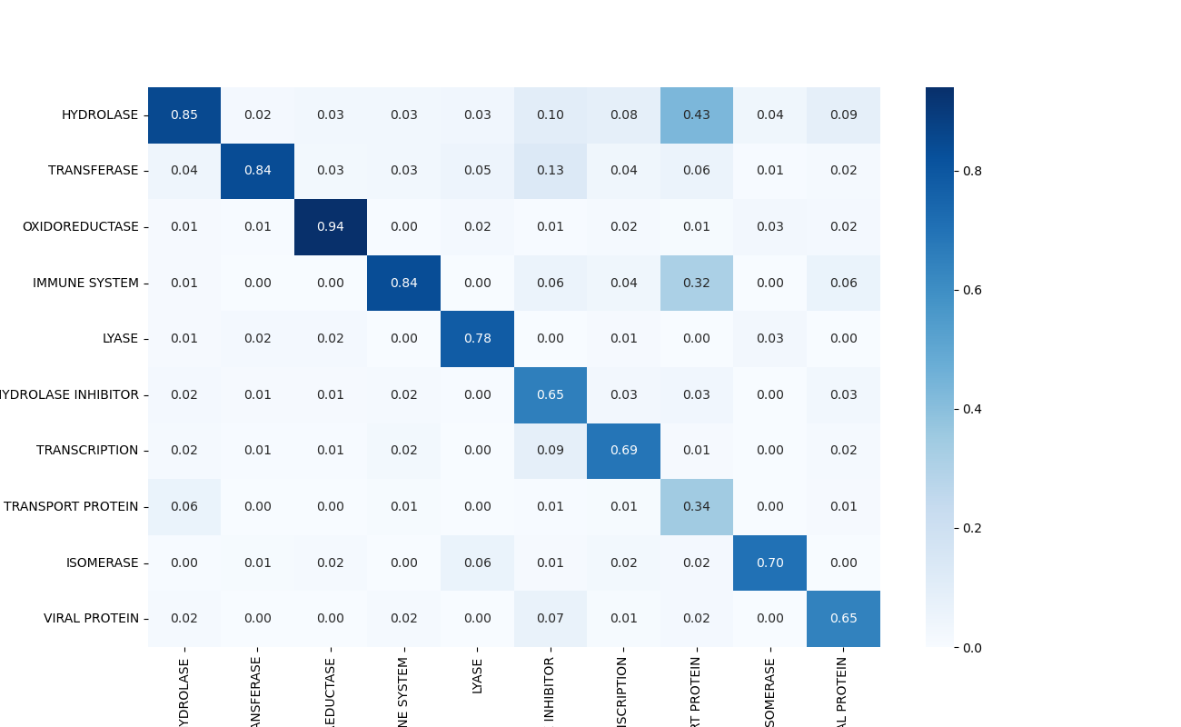
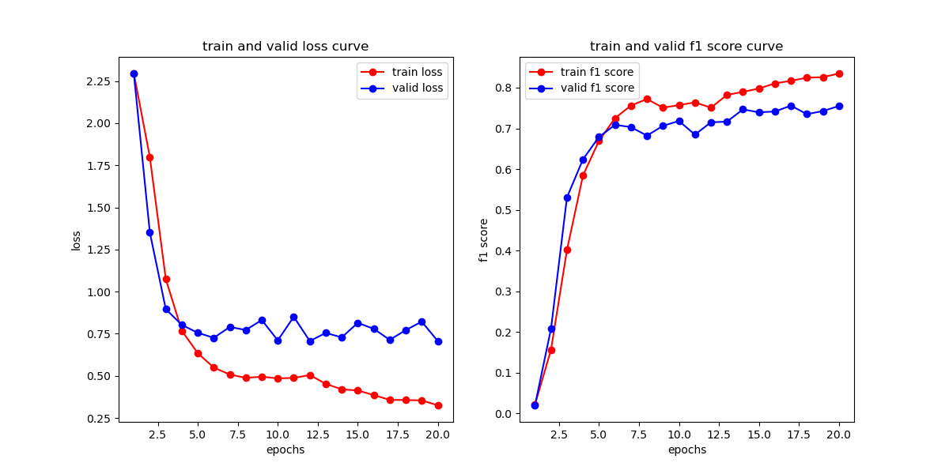
Task 1 : protein classification (PDB class)
DistillProtBert model
F1 : 0.742

Slide 23
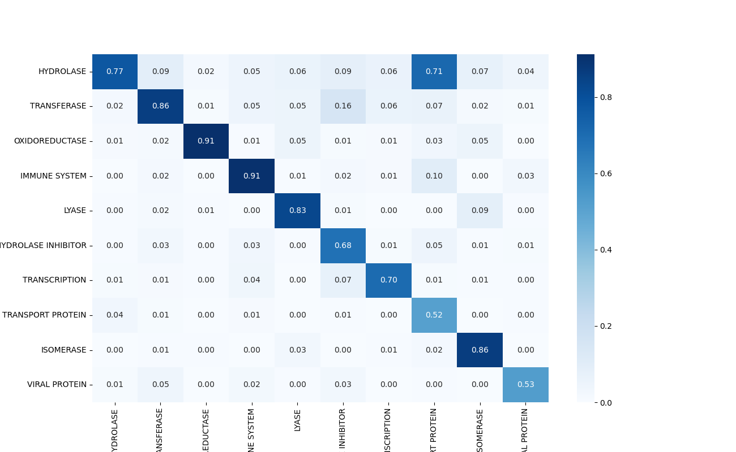
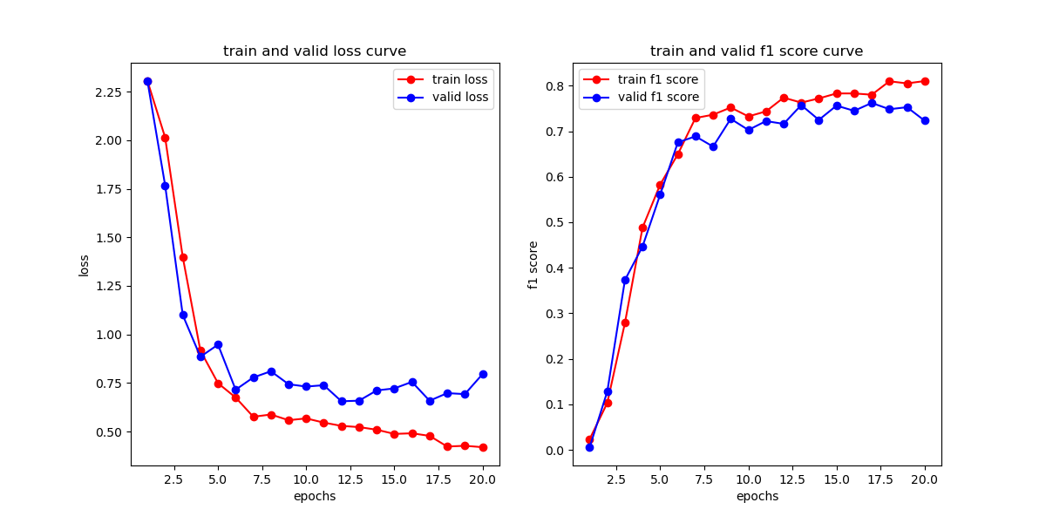
Task 1 :protein classification (PDB class)
ProtBert model
F1 : 0.754

Slide 24
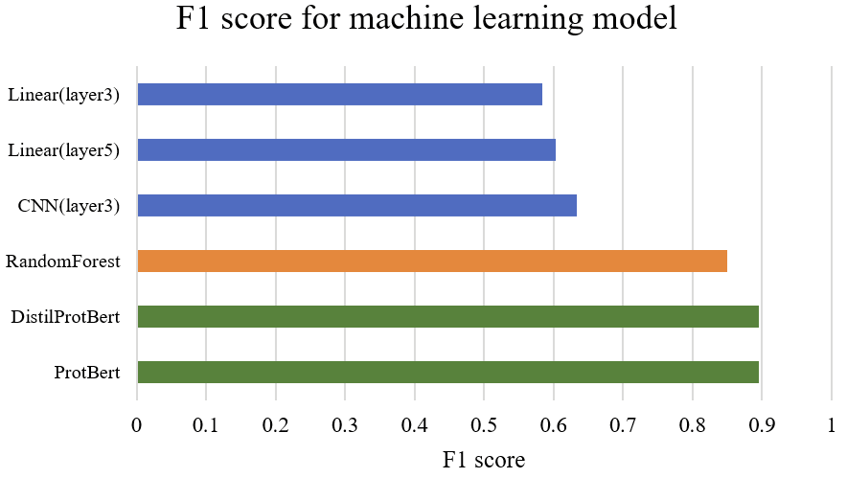
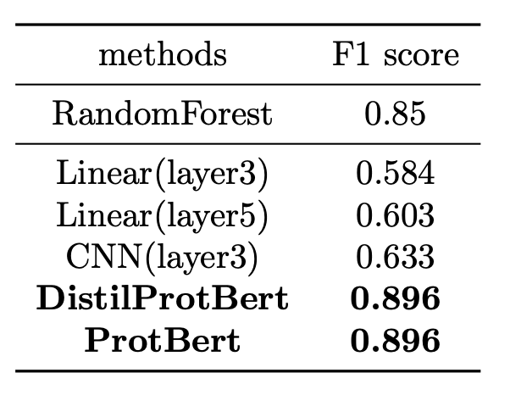
Task 2 : protein classification (CATH class)
Notes:
사실 attetion 하나만 써도 0.9 나왔음
이거는 atteino이 가장 re 좋은 방법이라는걸보여줌?
good generalization
scrath bert는 학습이 어려웠음

Slide 25
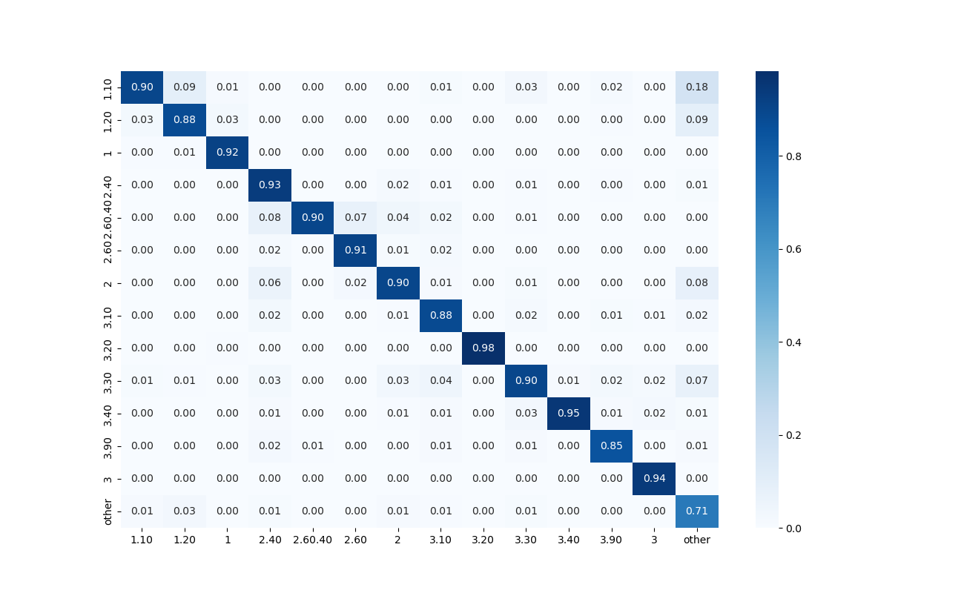
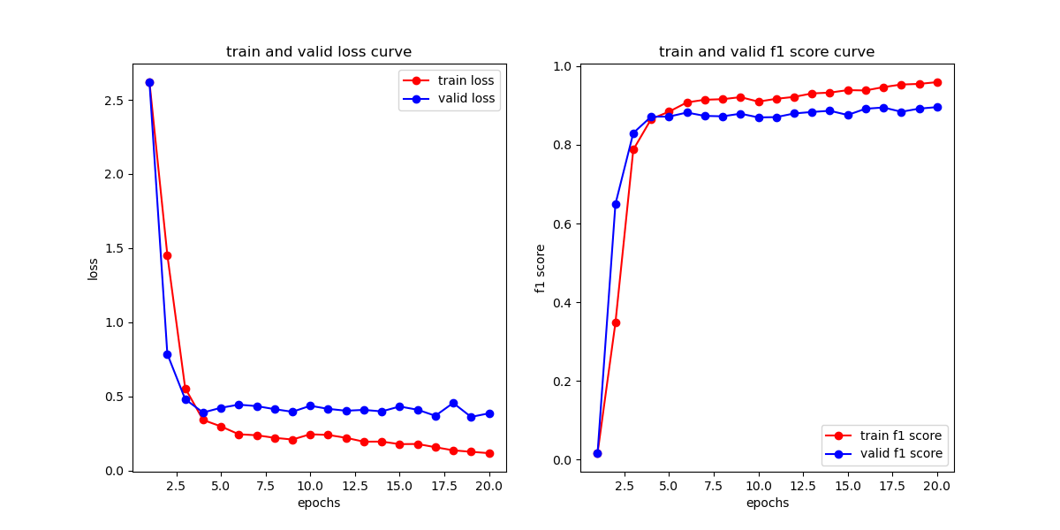
Task 2 : protein classification (CATH class)
DistillProtBert model
F1 : 0.896

Slide 26
Conclusion
1
ProtBert shows higher performance compared to other methods.
2
Confirmed that 'transfer learning' is possible.
3
Pre-trained parameters have useful information.

Slide 27
Discussion

Slide 28

Discussion
Is it possible to generate MSA from ProtBert?
Improving MSA performance by training with additional information
Further study: Protein Binding
?
?
Notes:
생각보다는 매우 좋은 성능은 아니였다
문제 자체가 문제인지? 아니면 버트가 생각보다 별로인건지?
우리가 bert를 학습한 걸로 msa를 임의로 생성할수 있을까?
1번에 이어서 추가적인 정보를 넣어서 학습하면 msa 성능향상이 될까?
protein binding 에 대해서 확장해보고 싶다
bert가 생각보다는 좋은 성능은 아니였다

Slide 29
Thank you
Any questions?

